Slide 1
Data simulation 18 October 2021
Refs/sources:
Charles DiMaggio: Intro to simulations in R
https://aosmith.rbind.io/2018/08/29/getting-started-simulating-data/

Slide 2
Why simulate?
Produce data to play around with.
Generate data similar to what we expect to collect to see if our proposed analysis works as expected.
Run a power analysis to determine necessary sample size

Slide 3
Steps to simulating your dataset
Define your expected dataset
Produce Response variable using a random draw from appropriate probability distribution
Produce Predictor data

Slide 4
1. Define your predicted dataset
What are your response & predictors?
What is the anticipated error distribution of your response?
How many samples will you have? How are these apportioned to each category of predictor?

Slide 5
2. Produce response variable
Use a random draw from appropriate probability distribution to produce response variable
If you have pilot data, you can use this to estimate parameters to use for the random draw.
Otherwise, need to use best guess

Slide 6
Probability distributions
Normal: norm(mean, sd)
Poisson: pois(lambda)
Binomial: binom(size, prob)
Uniform: unif(min, max)
ChiSquared: chisq(df, ncp)
Exponential: exp(rate)
Gamma: gamma(shape, scale)
Logistic: logis(location, scale)
T: t(df, ncp)
Beta: beta(shape1, shape2, ncp)

Slide 7
Probability Distributions
Most commonly used:
rnorm(n, mean, sd) for continuous outcomes
rpois(n, lambda) for count outcomes
rbinom(n, size = 1, prob) binary outcomes

Slide 8
Using probability functions in R
dxxx(x,) returns the density or the value on the y-axis of a probability distribution for a discrete value of x
pxxx(q,) returns the cumulative density function (CDF) or the area under the curve to the left of an x value on a probability distribution curve
qxxx(p,) returns the quantile value, i.e. the standardized z value for x
rxxx(n,) returns a random simulation of size n

Slide 9
Probability functions
rnorm(n = 10, mean = 50, sd = 19) # normal distribution
runif(n = 10, min = 0, max = 1) #uniform distribution
rpois(n = 10, lambda = 15) # Poisson distribution, lambda = mean/variance
# toss coin 8 times using binomial distribution
rbinom(n = 8, size = 1, p = 0.5)
# 18 trials, sample size 10, prob success =.2
rbinom(18, 10, 0.2)

Slide 10
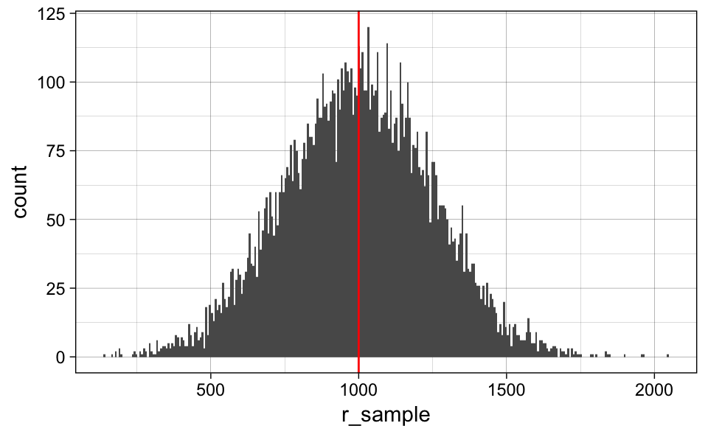
Random Data in R: rnorm
data.frame(r_sample = rnorm(n = 10000, mean = 1000, sd = 250)) %>%
ggplot(aes(x = r_sample)) +
geom_histogram(bins = 300) +
geom_vline(xintercept = 1000, color = 'red') +
theme_linedraw()

Slide 11
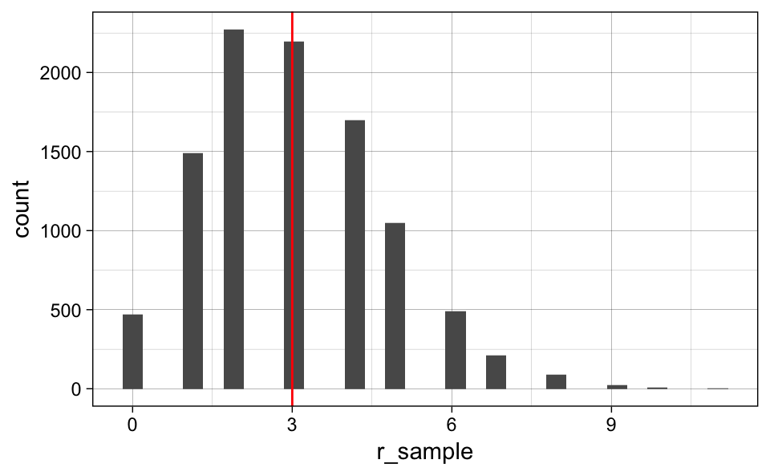
Random Data in R: rpois
data.frame(r_sample = rpois(n = 10000, lambda = 3)) %>%
ggplot(aes(x = r_sample)) +
geom_histogram() +
geom_vline(xintercept = 3, color = 'red') +
theme_linedraw()

Slide 12
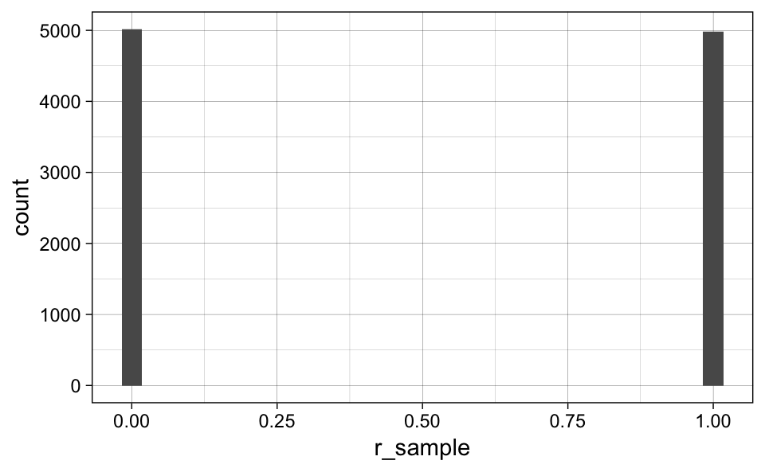
Random Data in R: rbinom
data.frame(r_sample = rbinom(n = 10000, size = 1, prob = 0.5)) %>%
ggplot(aes(x = r_sample)) +
geom_histogram() +
theme_linedraw()

Slide 13
3. Produce predictor data
Useful functions:
rep()
expand.grid()
seq()
runif()

Slide 14
rep()
Use c(“a”, “b”, “c”.....)
Each = # of times you rep each one
Times = number of times you rep the whole vector
Length = replicate until you get a vector of this length
Need to use factor() around rep function to create a factor.

Slide 15
Expand.grid()
Expand.grid(
gender=c("M", "F"),
education=c("HS", "College", "Advanced"),
status=c("Single", "Married", "Divorced", "Widowed"))
Gives you every possible combination of these variables.

Slide 16
Other packages to explore
Simstudy- simulate study data
https://cran.r-project.org/web/packages/simstudy/vignettes/simstudy.html
simr: power analyses for glmm using simulation

